Slide 1
XCIST simulation & recon tests: Artifact study with analytic phantom

Slide 2
Analytic artifact phantom experiments – baseline (over-rides)
Phantom
analytic (200x300-mm water, 40-mm-diameter bone, 20-mm-diameter titanium, 10-mm-diameter iron)
Scanner
1-mm focal spot width
1-mm detector column width
900 detector columns
1 detector row (64 for scatter)
¼-detector column offset (0 for view aliasing)
Protocol
1-s rotation
500 mA
2000 views/rotation (500 for view aliasing)
maxPrep = 9
Physics
88 keV (120 kV for beam hardening)
Quantum noise off (on for noise)
Electronic noise off (on for noise)
Scatter off (on for scatter)
Source sampling = 2
Detector sampling = 2
View sampling = 2
BHC off
Recon
1 slice
0.568-mm slice thickness (native)
300-mm FOV
No offset
Standard kernel
HU
Water mu = mu_{water(88 kev)} (0.2 for beam hardening)

Slide 3
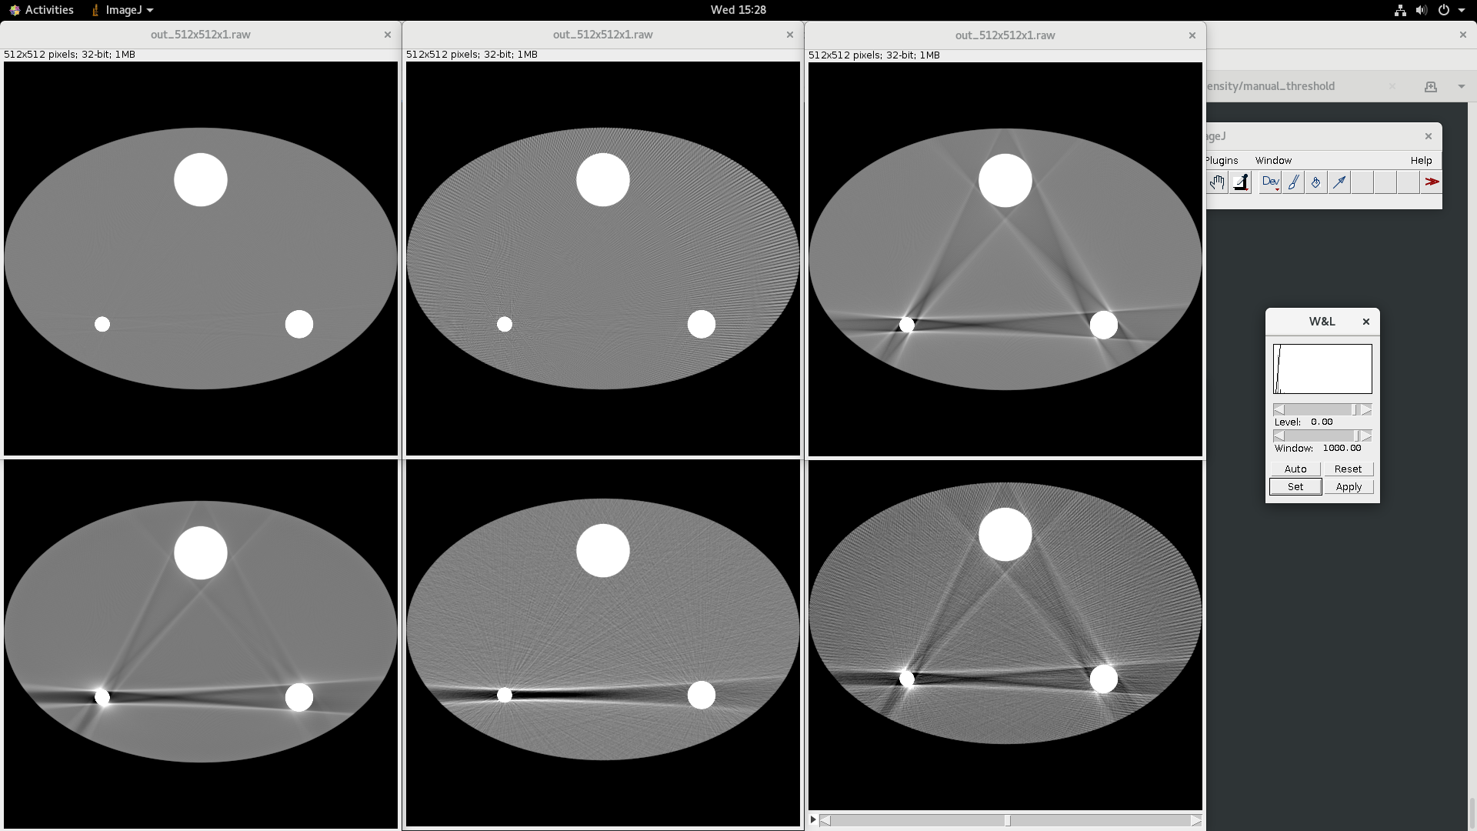
From Jiayong

Slide 4
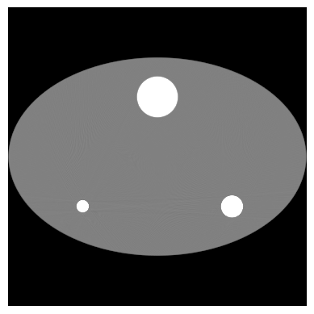




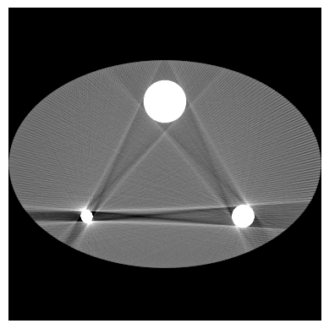
200-mm × 300-mm water
40-mm-diameter bone
Ideal
View aliasing, 500 views
Beam hardening
10-mm-diameter iron
20-mm-diameter titanium
Scatter
Noise, 500mA, maxPrep = 9
All artifact sources

Slide 5



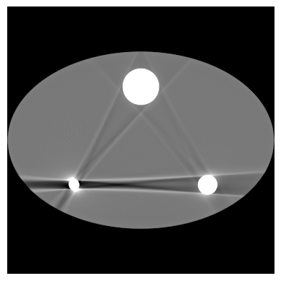

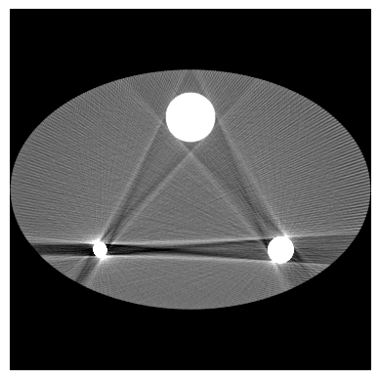
200-mm × 300-mm water
40-mm-diameter bone
Ideal
View aliasing, 500 views
Beam hardening
All artifact sources
10-mm-diameter iron
20-mm-diameter titanium
W/L 800,0
Scatter
Noise, 300mA
All artifact sources

Slide 6


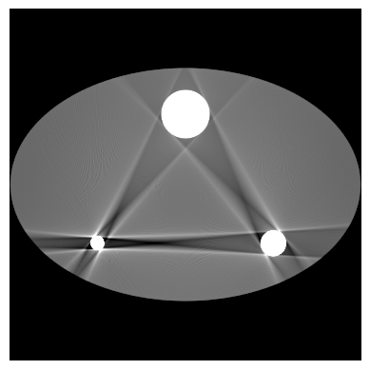



200-mm × 300-mm water
40-mm-diameter bone
Ideal
View aliasing, 500 views
Beam hardening
All artifact sources
10-mm-diameter iron
20-mm-diameter titanium
W/L 600,0
Scatter
Noise, 300mA
All artifact sources

Slide 7

200-mm × 300-mm water
40-mm-diameter bone
Ideal
View aliasing, 400 views
Beam hardening
All artifact sources
10-mm-diameter iron
20-mm-diameter titanium
W/L 600,0
Scatter
Noise, 300mA
All artifact sources

Slide 8


200-mm × 300-mm water
40-mm-diameter bone
Ideal
View aliasing, 360 views
Beam hardening
10-mm-diameter iron
20-mm-diameter titanium
W/L 600,0
Scatter
Noise, 500 mA
All artifact sources

Slide 9





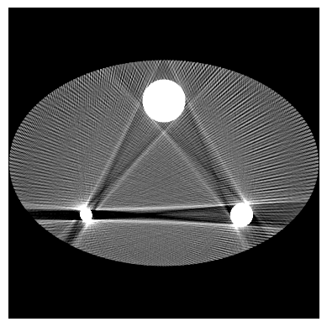
200-mm × 300-mm water
40-mm-diameter bone
Ideal
View aliasing, 360 views
Beam hardening
10-mm-diameter iron
20-mm-diameter titanium
W/L 500,0
Scatter
Noise, 500 mA
All artifact sources

Slide 10





200-mm × 300-mm water
40-mm-diameter bone
Ideal
View aliasing, 360 views
Beam hardening
All artifact sources
10-mm-diameter iron
20-mm-diameter titanium
W/L 500,0
Scatter
Noise, 500 mA
All artifact sources
95 keV

